Slide 1
Survival and Hazards
Eamonn O’Brien
12 April 2021

Slide 2
Agenda
Distributions
  f(t) F(t) S(t) H(t) h(t)
  Exponential
  Weibull
Cox Proportional Hazards
  Simple case 1 categorical predictor
  Ranks
Simulation of survival times
Notes:
No discussions on Cox assumptions

Slide 3
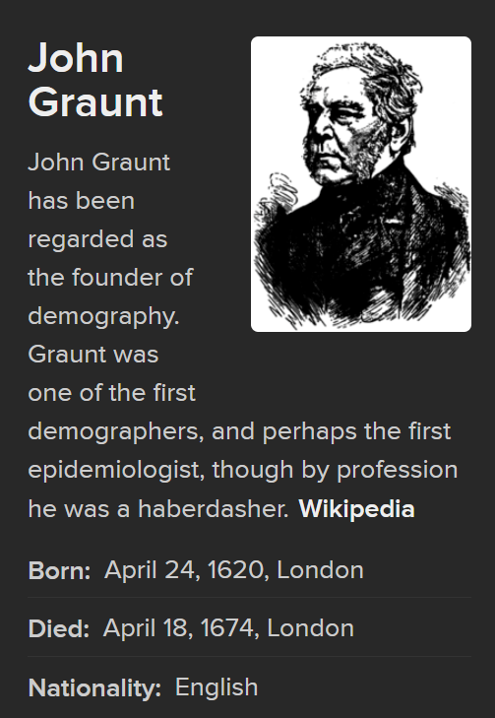
Survival Analysis
The development dates back to the 17th century with the first life table ever produced by John Graunt in 1662.
The term ‘survival analysis’ has been used for data involving time to a certain event such as death, onset of a disease or relapse of a condition.
However, this event of interest may not be observed within the relevant time period, producing so-called censored observations

Slide 4

R Survival package
https://www.amstat.org/ASA/Your-Career/Awards/W-J-Dixon-Award-for-Excellence-in-Statistical-Consulting.aspx

Slide 5
The jargon
f(t) probability density function (p.d.f)
F(t) cumulative distribution function (c.d.f)
S(t) survivor function
h(t) hazard function
H(t) cumulative hazard function
In addition to the 5 above, which are all different ways of summarizing the same information, a sixth way, inverse transform sampling, Q(t), is of use to simulate survival-time data sets.

Slide 6
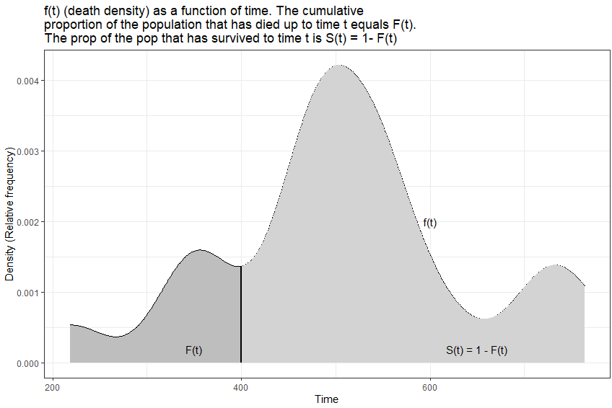
Probability density function f(t)
When the variable under consideration is the length of time taken for an event to occur (e.g. death) a frequency histogram can be constructed to show the count of events as a function of time.
A curve fitted to this histogram produces a death density function f(t).
Set the area under the curve of the death density function to equal 1
Then for any given time t the area under the curve to the left of t represents the proportion of individuals in the population who have experienced the event of interest.
The proportion of individuals who have died as a function of t is the cumulative (death) distribution function and is called F(t).
Notes:
CDF to PDF we differentiate; PDF to CDF we integrate 218 338 352 366 434 470 476 478 484 491 509 528 535 543 562 562 618 714 728 764

Slide 7
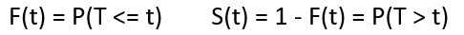
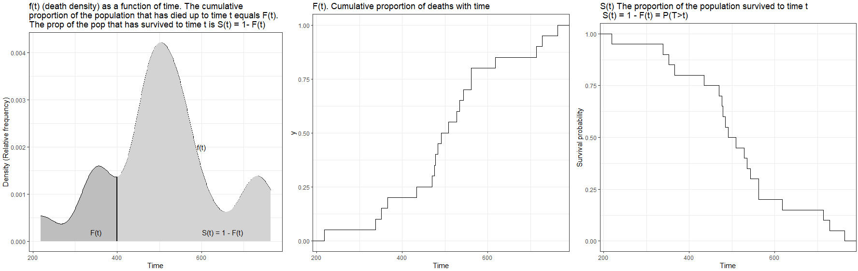
f(t) F(t) and S(t)
So, the survivor function S(t), is the reverse cumulative distribution function of T:
Notes:
CDF to PDF we differentiate; PDF to CDF we integrate

Slide 8
The jargon
f(t) probability density function (p.d.f)
F(t) cumulative distribution function (c.d.f)
S(t) survivor function
h(t) hazard function
H(t) cumulative hazard function
Given one of the above that describe the probability distribution of failure times, the others are completely determined.

Slide 9
1. h(t) hazard function
h(t) = limit Δt -> 0 P(t < X ≤ t+Δt | X > t) / Δt
Limit as Δt goes to zero, the probability that event X happens in the some interval between t and t + Δt conditional on the event that X > t, all divided by Δt.
A.k.a. conditional failure rate, force of mortality, instantaneous rate of failure, instantaneous risk, intensity function
From the definition of the hazard function, it can be shown:
h(t) = f(t) / S(t) [hazard function = pdf / survival function]

Slide 10
2. h(t) hazard function
h(t) = limit Δt -> 0 P(t < X ≤ t+Δt | X > t) / Δt Units 1/t
It is the (limiting) probability that the failure event occurs in a given interval, conditional upon the subject having survived to the beginning of that interval, divided by the width of the interval
The hazard rate (or function) can vary from zero (no risk at all) to infinity (meaning the certainty of failure at that instant)
Over time, the hazard rate can increase, decrease, remain constant, or take on many shapes
There is a one-to-one relationship between the probability of survival past a certain time and the amount of risk that has been accumulated up to that time, and the hazard rate measures the rate at which risk is accumulated.

Slide 11
3. h(t) hazard function
It is the underlying process (for example, disease, machine wear) that determines the shape of the hazard function
When the risk of something is zero, its hazard is zero.
Even if risks do not vary over time you will succumb eventually (provided that the constant risk or hazard is non zero), but your chances of succumbing at this instant or that instant are all the same.
If the risk is rising with time, so is the hazard. The future is bleak.
If the risk is falling with time, so is the hazard. Here the future looks better (if we can make it through the present).
The human mortality pattern related to aging generates a falling hazard for a while after birth and thereafter constantly rising and eventually reaching, near infinity at about 100 years.
  The "bathtub hazard".
The hazard function is at the heart of survival analysis

Slide 12
Cumulative hazard H(t) and S(t)
f(t) = d/dt[1-S(t)] = -d/dt S(t)
we know h(t) = f(t)/S(t) and from differential calculus
h(t) = -d/dt S(t) / S(t) = - d/dt ln S(t)
So, H(t) = - ln S(t)

Slide 13
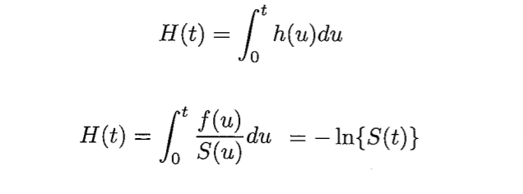
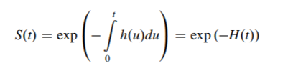
Cumulative hazard H(t) and S(t)
Cumulative hazards are the integral from zero to t of the hazard rates.

Slide 14
Interpretation of cumulative hazard
The cumulative hazard function interpretation: it measures the total amount of risk that has been accumulated up to time t
An interpretation of the cumulative hazard is that it records the number of times we would expect to observe failures over a given period, if only the failure event were repeatable.
So a cumulative hazard of 7 for death over an x year period means that we would expect to die 7 times, and as if in a video game, each time we died we could be instantly resurrected and continue playing.
Probabilities are not the best way to think about cumulative hazards.

Slide 15
We can now conveniently write:
H(t) = -ln(S(t)) [earlier slide]
S(t) = exp(-H(t)) [rearrange]
F(t) = 1- exp(-H(t)) [as we know S(t) = 1-F(t)]
f(t) = h(t)exp(-H(t)) [since h(t) = f(t) / S(t) from hazard definition]
Given one of the above that describe the probability distribution of failure times, the others are completely determined.
It is said determining a hazard from a density or distribution is really turning the problem on its head.
Good to think in terms of hazard functions, as the hazard function is at the heart of survival analysis

Slide 16
Office of National Statistics Life Table (pre covid)
https://www.ons.gov.uk/peoplepopulationandcommunity/birthsdeathsandmarriages/lifeexpectancies/datasets/nationallifetablesunitedkingdomreferencetables
Q: Assuming things stay the same as now, what is the average number of years an x year old female can expect to live?
Q: What is the probability a male aged x will reach hundred?
Q: What is the probability that a person aged x exactly will die before reaching age (x +1)?

Slide 17
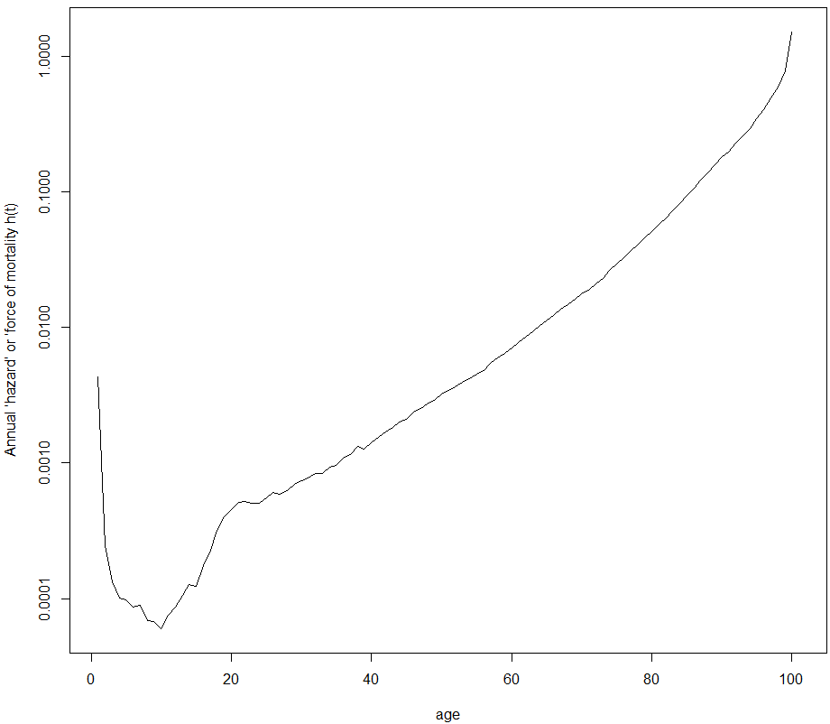
Human mortality life table data, ‘bathtub hazard’
d <- c( 426.7, 24.2, 13.1, 10.0, 9.7, 8.5, 8.8, 6.8,
6.7, 5.9, 7.4, 8.5, 10.4, 12.6, 12.1, 17.3,
22.6, 31.4, 39.8, 44.5, 50.4, 50.9, 50.0, 50.0,
54.7, 59.2, 57.5, 61.4, 68.7, 72.3, 76.1, 82.3,
82.3, 91.5, 94.1, 105.5, 112.5, 128.3, 123.5, 136.8,
149.3, 162.8, 176.9, 194.6, 203.0, 227.2, 240.2, 259.7,
273.9, 305.4, 322.6, 343.1, 370.4, 389.5, 421.1, 445.7,
502.2, 542.8, 589.1, 634.4, 690.5, 750.0, 825.2, 902.3,
960.5, 1043.5, 1142.9, 1221.3, 1312.3, 1418.8, 1474.7, 1605.3,
1731.7, 1933.7, 2078.2, 2255.3, 2442.8, 2606.9, 2807.8, 2968.1,
3170.9, 3338.1, 3473.9, 3676.0, 3820.8, 3905.8, 3991.4, 3956.3,
3921.6, 3818.9, 3456.3, 3260.5, 2944.2, 2581.5, 2243.5, 1874.0,
1521.2, 1150.9, 858.3, 656.0, 430.2)
haz <- (d/sum(d)) / (1-cumsum(d/sum(d)))
plot(haz, t='l', log="y",
xlab="age", ylab="Annual ‘hazard’ or ‘force of mortality h(t)",
main="Annual risk of death in males from all causes for UK 2017-19")
‘He not busy being born is busy dying’
d=number dying per 100K live births between exact age x and (x +1), 0 to 100 yrs
dx/sum(dx) # f(t) the pdf
cumsum(dx/sum(dx)) # F(t) the cdf
St <- 1 - cumsum(dx/sum(dx)) # S(t) = 1-F(t)
h <- (dx/sum(dx)) / St # h(t) = f(t)/S(t)

Slide 18
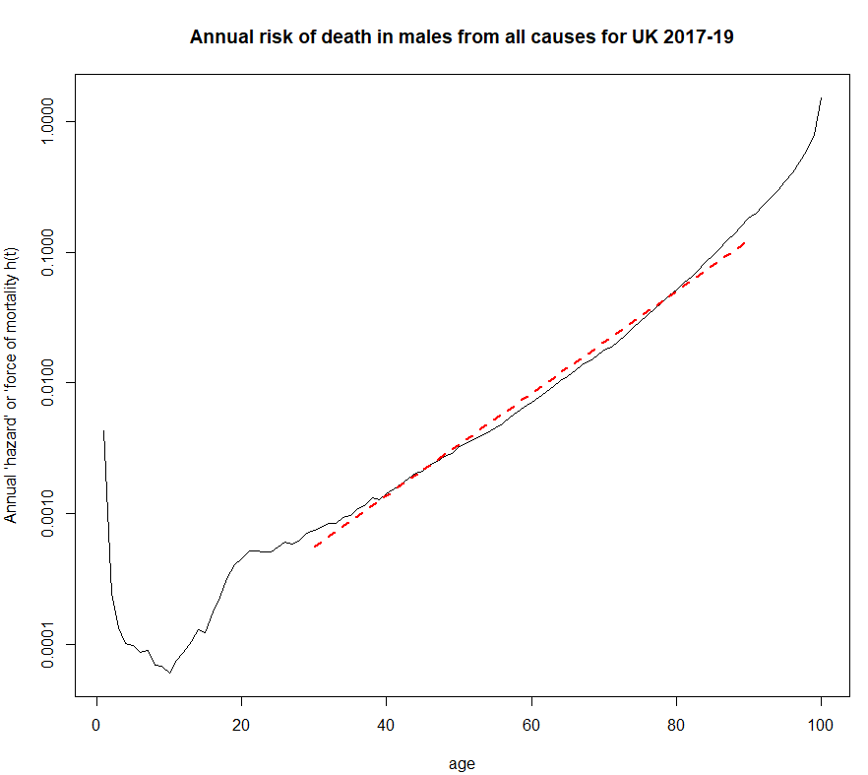


Human mortality life table data, ‘bathtub hazard’
Steep decline once survived early childhood, to a minimum of < 1 in 10,000 at around 10 years old.
Then, after a risk-taking bulge between 15 and 25, there is a reasonably straight line until around 90.
This linear growth on a logarithmic scale corresponds to an exponential growth in annual hazard. The risk of dying each year increases by a fixed proportion for each year we age.
The increase in annual hazard associated with ageing 1 year is roughly around 1.1$. This means that the average chance of dying before a next birthday increases by around 10 % for each year of ageing regardless of age (if over 25).
Equivalently, the average risk of dying before a next birthday doubles roughly every 7 years: 1.1⁷ ~ 2
$ Regress log(y)~x for subset and exponentiate slope coefficient

Slide 19
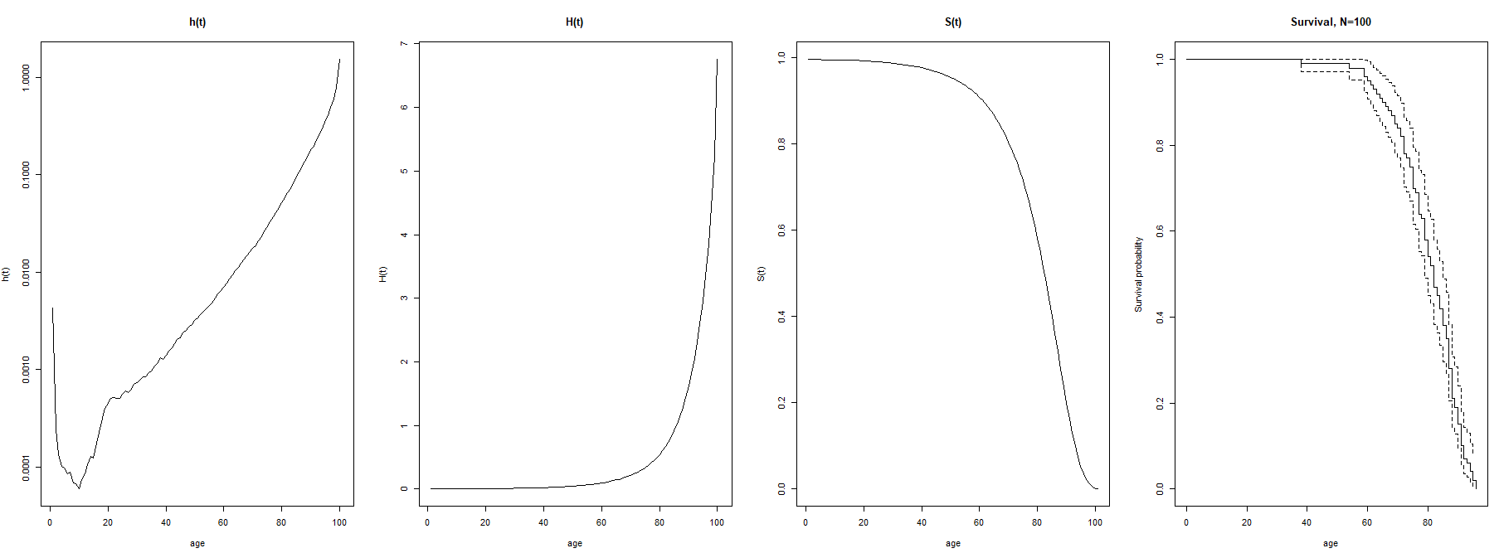
Human mortality life table data
cumhaz <- cumsum(haz) Surv <- exp(-cumhaz)
From the life table data, we calculate h(t), H(t) and S(t)
Randomly sample 100 subjects from the survival curve and present (rightmost)
Based on data for the years 2017-2019 UK Males (pre COVID)

Slide 20
Exponential, risks that do not vary over time
The exponential distribution is the simplest possible parametric distribution for survival times.
Will succumb eventually (provided that the hazard is nonzero), but the chances of succumbing at this instant or that are all the same.
Knowledge of what has occurred in the past has no effect on future probabilities. This is referred to as the memoryless property. Having survived to any time t, the probability of surviving dt units more is always the same, no matter what t is
This means that an older person is not any more likely to succumb at any particular time than a younger person. In other words, you are as good as new until sudden death. ‘If human lifetimes were exponential there wouldn’t be old or young people, only lucky or unlucky ones’ (Efron and Hastie https://en.wikipedia.org/wiki/Survival_function)

Slide 21
A simple hazard calculation
The hazard below is the exponential distribution hazard rate estimate, the number of events divided by exposure (the sum of all failure and censoring times in years)
Number of events trt1 = 141, Exposure in years =6870, Hazard = 0.021
Number of events trt2 = 98, Exposure in years =3784, Hazard = 0.026

Slide 22
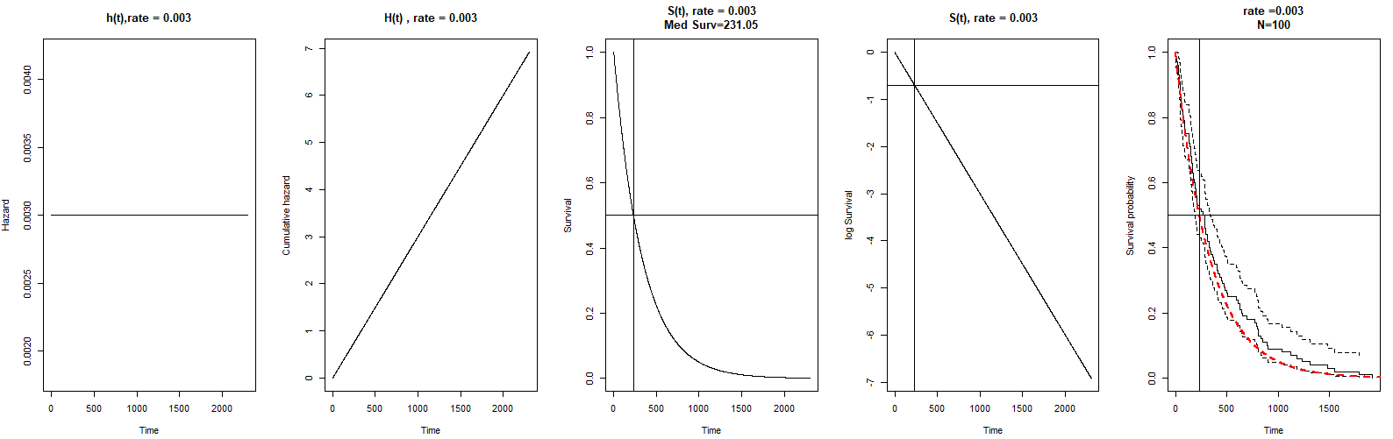
Exponential, risks that do not vary over time
Note: median survival above is at time 231, due to censoring it would be wrong to state half of the patients were alive at time 231 after starting say treatment.
It is correct to state the probability of surviving to time 231 or longer (so at least to time 231) after starting treatment is 0.5

Slide 23
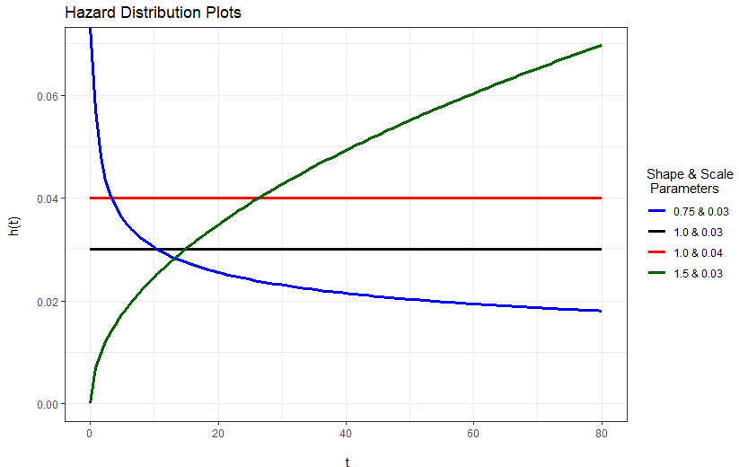
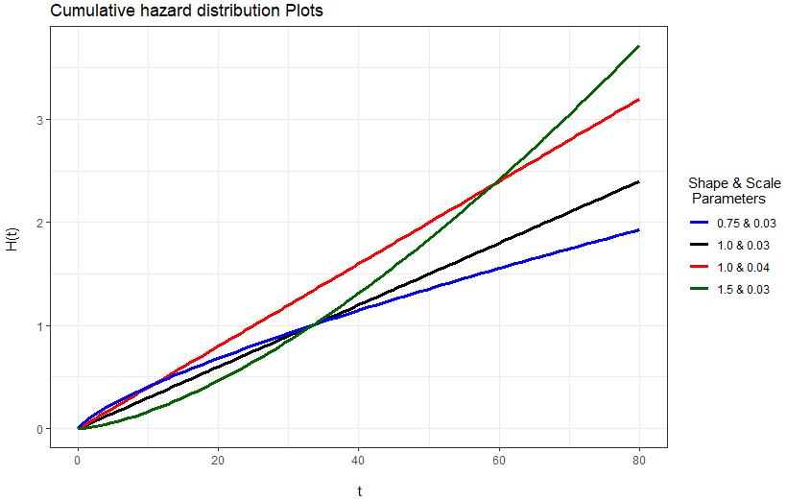
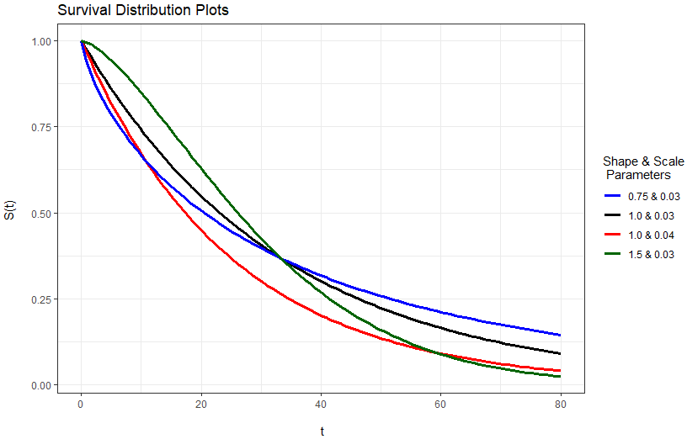

Weibull
When the shape is >1 in the Weibull distribution, it implies that hazards increase the longer you survive ; and when it is <1 (above) it implies hazards decrease. It has the exponential distribution as a special case (i.e. when the shape parameter = 1).
So even if the data truly is exponential, we only add a little more noise to our estimates by using a Weibull distribution over an exponential distribution.
Note the straight lines in the cumulative hazard plots

Slide 24
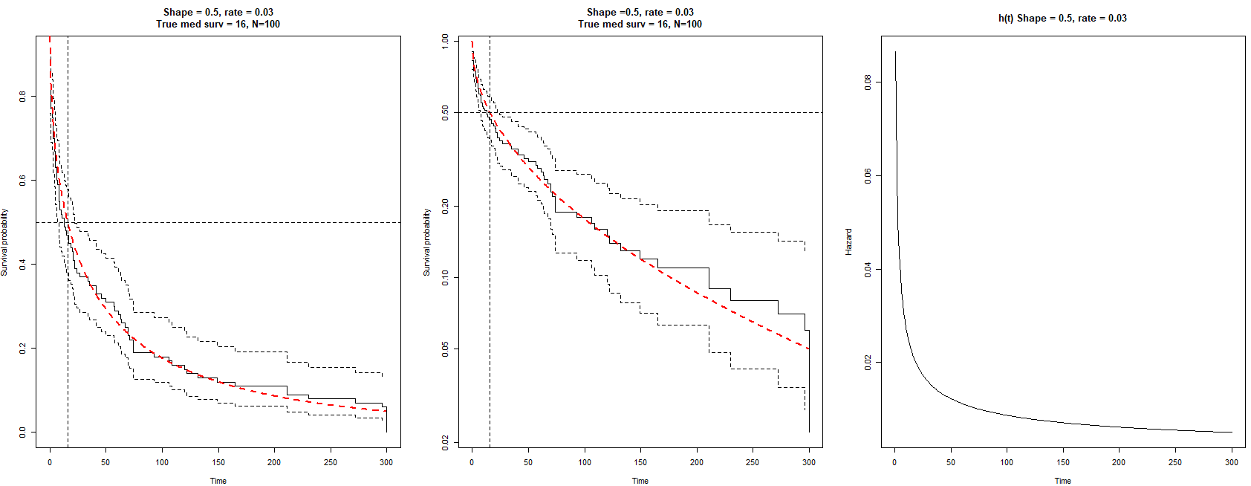
Weibull, shape=.5, rate=.03

Slide 25
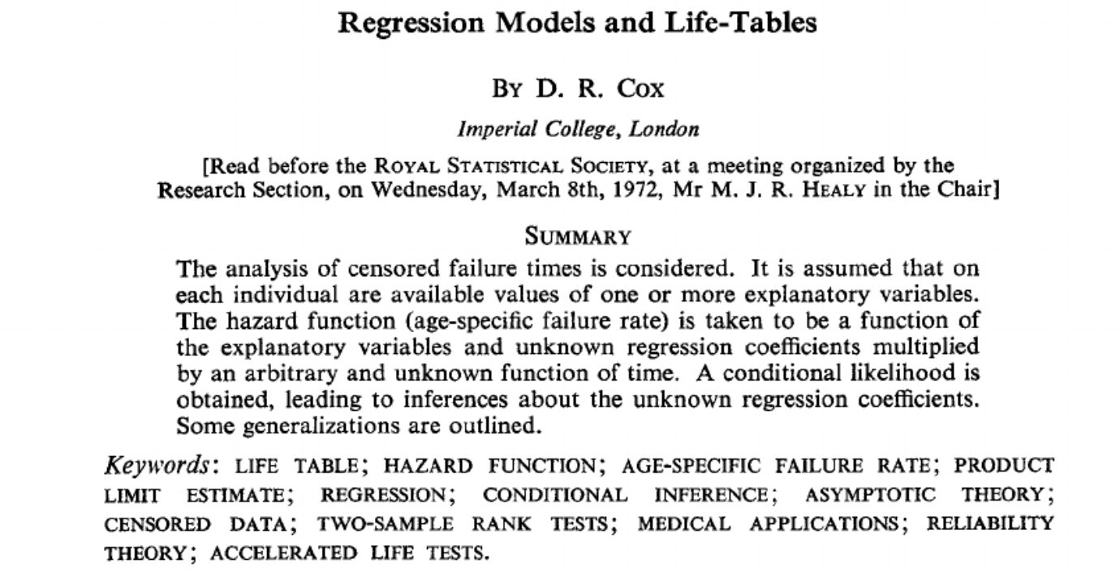
https://rss.onlinelibrary.wiley.com/doi/epdf/10.1111/j.2517-6161.1972.tb00899.x
Cox Proportional hazard model, 1972

Slide 26

Cox Proportional hazard model
The dominating regression model in survival analysis is the proportional hazards model (or Cox model). There is undoubtedly a somewhat uncritical use of the Cox model in the medical field.
Cox was concerned with the extension of the results of Kaplan and Meier to the comparison of life tables and more generally to the incorporation of regression-like arguments into life-table analysis.
This semi-parametric model consists of two parts. The first component is the baseline hazard, which is a function of time and describes how risk varies over time.
The second component is an exponential function of a linear combination of the predictors and is independent of time.

Slide 27





  Cox Proportional hazard model
Develop partial likelihood function. Sort by shortest time so first subject has highest hazard rate h₁.
X₁ is 1 or 0 for subject 1.
Taking the sum of hazards overall samples we obtain the risk set as
The likelihood for subject 1 to have the event at time t is simply the ratio of hazard over the risk set
The likelihood for subject 2, note subject 1 is no longer in the risk set
Substitute and cancel h₀(t)

Slide 28


  Cox Proportional hazard model
Multiply all the partial likelihoods together
However to avoid numerical problem work on log scale
Delta is the censoring code and takes 0 or 1, if delta is zero the subject’s partial likelihood is 0.
The product of probabilities is only taken over the individuals for whom death times are recorded. So censored individuals do not contribute to the numerator of the likelihood function. But they are included in the summation over the risk sets at death times that occur before a censored time.
The Newton-Raphson algorithm is used to solve the partial likelihood equation searching for best estimate of β that maximises the log PL.

Slide 29
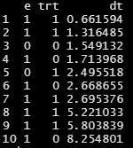
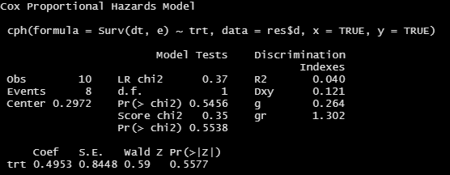

How to estimate HR, coefficient β
Example of CPH n=10 and 1 binary variable
Cox PH
Null Model and Model log likelihood
e = dead/censored
trt = treatment indicator
dt = time to event
No ties
L(data|β); probability that data could be generated by model with parameter β. Fix the data, vary the parameter.
Notes:
No ties in data;

Slide 30
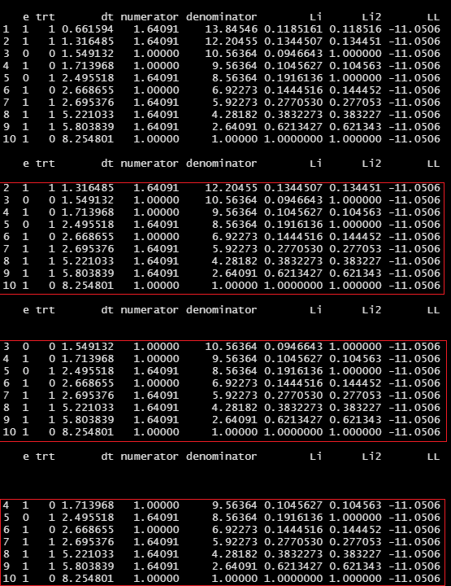

Estimate β by maximizing the partial log likelihood
Risk sets of subjects still being followed up at each time that an event occurred
Perform 1 analysis per failure time (risk groups based on order)
numerator = (initial guess at HR ) x trt indicator
denominator = sum numerators for the risk set
Li = numerator/denominator
Li2 if censored individual contributes 1
LL = log the product* of Li2 to get log likelihood
Repeat until log likelihood maximized. Find the parameter value at which the data is likely as possible, L(data| β)
Reality, calculations are done on the log scale, but here we don’t log the data as n=10 (so no numerical problems when multiplying small probabilities*)
Null Model and Model log likelihood
Notes:
No ties in data; It is based on considering the risk sets of subjects still being followed up at each time that an event occurred.

Slide 31
Estimate β by maximizing the partial log likelihood
Risk sets of subjects still being followed up at each time that an event occurred
Analysis at time 1: the probability that subject 1 is the one that fails in a dataset containing all 10 subjects.
Analysis at 2nd rank time : the probability that subject 2 is the one that fails in a dataset containing subject 2 and subjects 3,4,56,7,8,9 and 10.
…
So, supply a value of β and we will tell you a probability.
Last subject always numerator=denominator, the prob. that subject 10 is the one that fails in a dataset containing only subject 10. So it does not matter if the last subject fails or not!
Notes:
No ties in data; It is based on considering the risk sets of subjects still being followed up at each time that an event occurred.

Slide 32
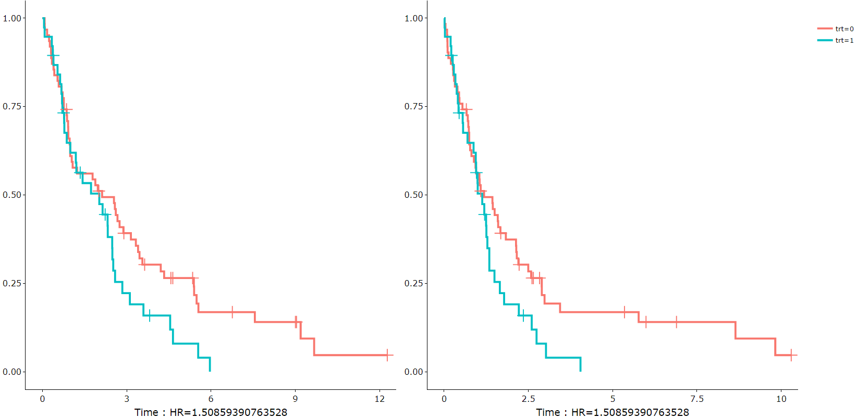
Only event order matters for Cox PH
Original recorded times to events
Sort dataset by event time and replace times with sorted random time, HR not affected
Notes:
Not times themselves, kept the times to be reasonably similar to true times. Does not have to be like that.

Slide 33
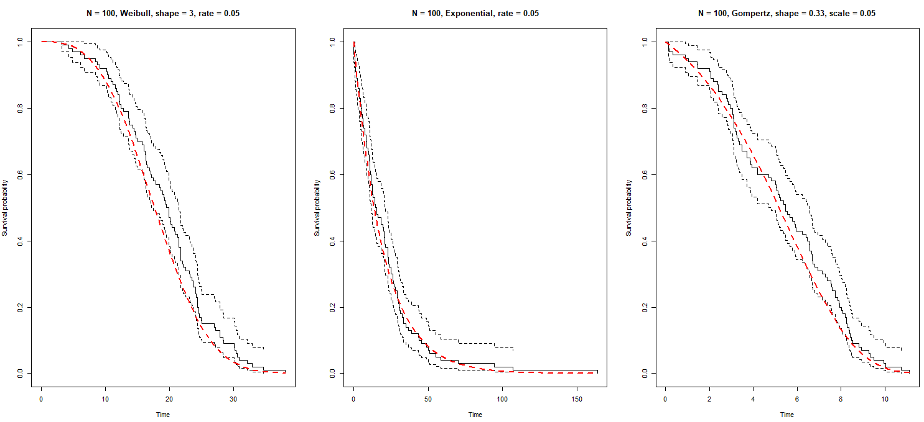
Simulation of survival times (inverse sampling)
Uniformly distributed random numbers can be transformed into survival
times following a specific distribution.
It is just required to know the inverse of an appropriate cumulative baseline hazard function
Above, inverse sampling matches the true distributions in red (ref: Generating survival times to simulate Cox proportional hazards models, Bender, 2005, Stats in Medicine)

Slide 34
The End

Slide 35
Estimate β by maximizing the partial log likelihood
Risk sets of subjects still being followed up at each time that an event occurred
Reality, calculations are done on the log scale, but here we don’t log the data as n=10 (so no numerical problems*)
e = dead/censored ; trt = treatment indicator; dt = time to event
Perform 1 analysis per failure time (risk groups based on order)
numerator = (guess at HR) x trt indicator
denominator = sum numerators for the risk set
Li = numerator/denominator
Li2 if censored individual contributes 1
LL = log the product* of Li2 to get log likelihood
Repeat until log likelihood maximized L(β|data) (Newton-Raphson method)
Notes:
No ties in data; It is based on considering the risk sets of subjects still being followed up at each time that an event occurred.

Slide 36
4. h(t) hazard function
h(t) = limit Δt -> 0 P(t < X ≤ t+Δt | X > t) / Δt
Limit as Δt goes to zero, the probability that event X happens in the some interval between t and t + Δt conditional on the event that X > t, all divided by Δt.
From the definition of the hazard function, it can be shown:
h(t) = f(t) / S(t) [hazard function = pdf / survival function]

